Slide 1
HR _ ANALYTICS DASHBOARD
VALUE DRIVEN INSIGHT TABLEAU DASHBOARD
PRESENTED BY – ABHINAV KUMAR MISHRA
SNTI, TATA STEEL LTD. Near Shavak Nanavati Technical Institute, South Park,
Bistupur, Jamshedpur

Slide 2
ACHNOWLEDGEMENT
Firstly, I extend my deepest thanks to Mr. Kolati Raju for their invaluable support in providing the necessary data and insights essential for the development of this dashboard.
Their cooperation and willingness to share expertise were instrumental in ensuring the accuracy and relevance of the analytics showcased. Your collective efforts have been pivotal in shaping this HR Analytics Dashboard.
I would like to extend my sincere thanks to him.
Thank you for your contributions, guidance, and encouragement.

Slide 3
Introduction
An HR dashboard is a visual representation of various HR metrics and key performance indicators (KPIs) that provide a comprehensive overview of an organization's human capital. It serves as a centralized platform to monitor and analyze HR-related data in real-time or periodically. The concept revolves around presenting actionable insights to facilitate informed decision-making and strategic planning within the HR domain.
ROLE OF TABLEAU IN HR ANALYTICS DASHBOARD
Tableau plays a crucial role in creating and managing HR dashboards by offering powerful data visualization and analytics capabilities. In essence, Tableau serves as a powerful tool for HR professionals to visualize, analyze, and derive actionable insights from HR-related data, fostering data-driven decision-making and enabling HR departments to optimize processes and strategies for better workforce management.

Slide 4
CURRENT CONDITION
Increased Adoption: More organizations were adopting HR analytics to gain deeper insights into their workforce, talent acquisition, employee engagement, and overall HR processes. This trend was driven by the growing availability of HR data, advancements in technology, and the recognition of analytics as a strategic tool for HR decision-making.
Focus on Employee Experience: HR analytics was being used to analyze and enhance the employee experience. This included understanding employee sentiment, identifying factors affecting engagement, and optimizing HR processes to improve overall satisfaction.
Predictive Analytics: Some organizations were moving beyond descriptive analytics to predictive analytics. Predictive models in HR aimed to forecast future trends, such as turnover risk, talent gaps, and workforce planning. This allowed HR teams to take proactive measures based on anticipated challenges.
Diversity, Equity, and Inclusion (DEI) Analytics: There was an increased focus on using analytics to measure and improve diversity, equity, and inclusion in the workplace. HR analytics tools were being employed to track diversity metrics, identify areas for improvement, and monitor the effectiveness of DEI initiatives.
Learning and Development Analytics: Analytics tools were applied to measure the impact of training and development programs. HR professionals used data to assess the effectiveness of learning initiatives, identify skill gaps, and personalize training programs for employees.

Slide 5
ANALYSING PROBLEM
We have created five charts to analyse the following:
DEPARTMENT WISE ATTRITION
NUMBER OF EMPLOYEE BY AGE GROUP
JOB SATISFACTION RATING
EDUCATION FIELD WISE ATTRITION
ATTRITION RATE BY GENDER FOR DIFFERENT AGE GROUP

Slide 6
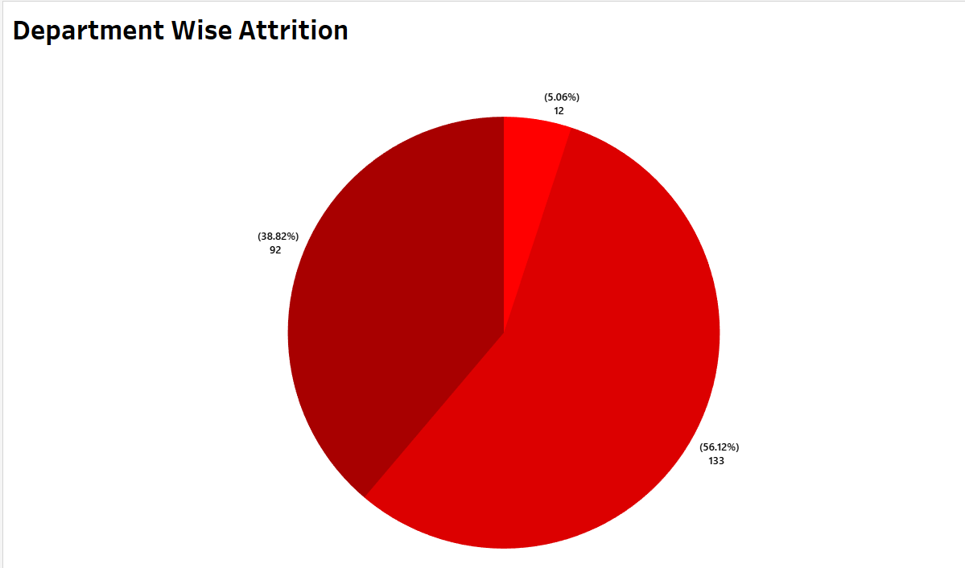
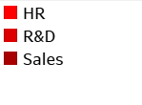
This is a Pie chart representation ,This chart indicates how many people have left the company from HR post ,Sales post and from R&D(research and development)post.
HR has 5.06% attrition rate with 12 attrition count.
R&D has 56.12% attrition rate with 133 attrition count.
Sales has 38.82% attrition rate with 92 attrition count.

Slide 7
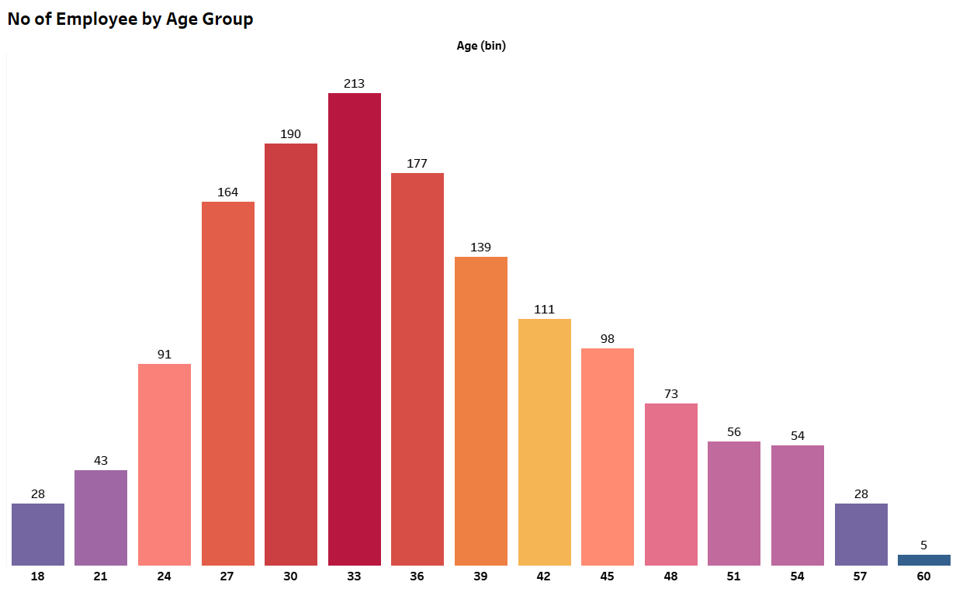
This is a graph chart representation ,This indicates the age wise employee count.
In the chart , the first graph represents 28 employee count at 18 year age bin.(we can change the age bin according to year gaps as we want)
Like this way we can check the No number of employees by different age group.

Slide 8
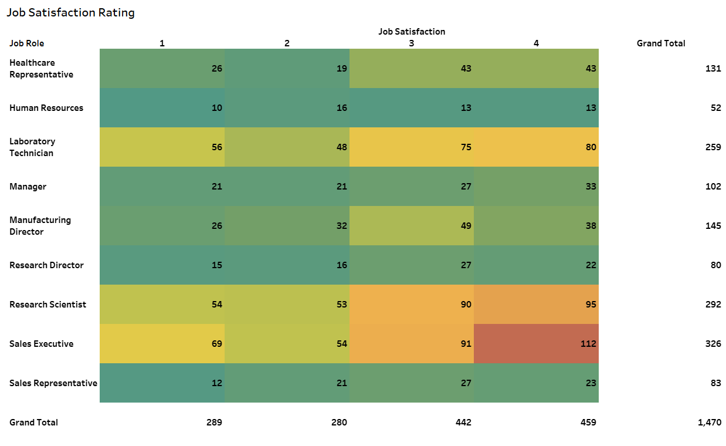
This is a tabular chart representation of Job Satisfaction Rating.
This table represents Rating of Job Satisfaction according to different Job Profile
Suppose In the First row of Job Column ,Healthcare Representative Role has 26 employee count who has rated 1% Job Satisfaction.

Slide 9
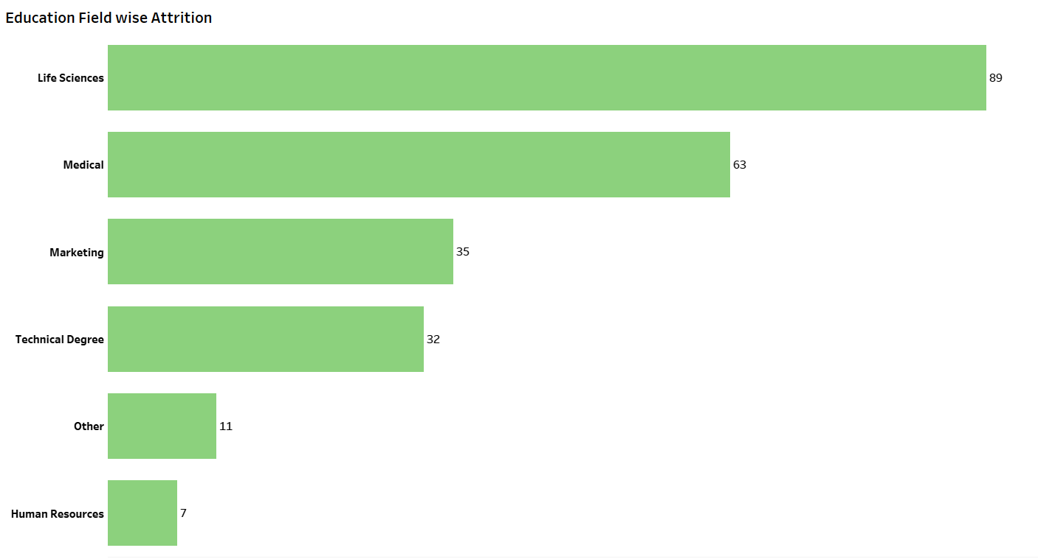
This is a Education Field wise Attrition Graph Chart.
This Graph indicate Education Fields which includes Life Sciences, Medical, Marketing, Technical Degree, Others and Human Resources.
Life sciences has 89 Attrition count.
Medical has 63 Attrition count.
Marketing has 35 Attrition count.
Technical Degree has 32 Attrition Count.
Other has 11 Attrition Count.
Human Resources has 7 Attrition Count.

Slide 10
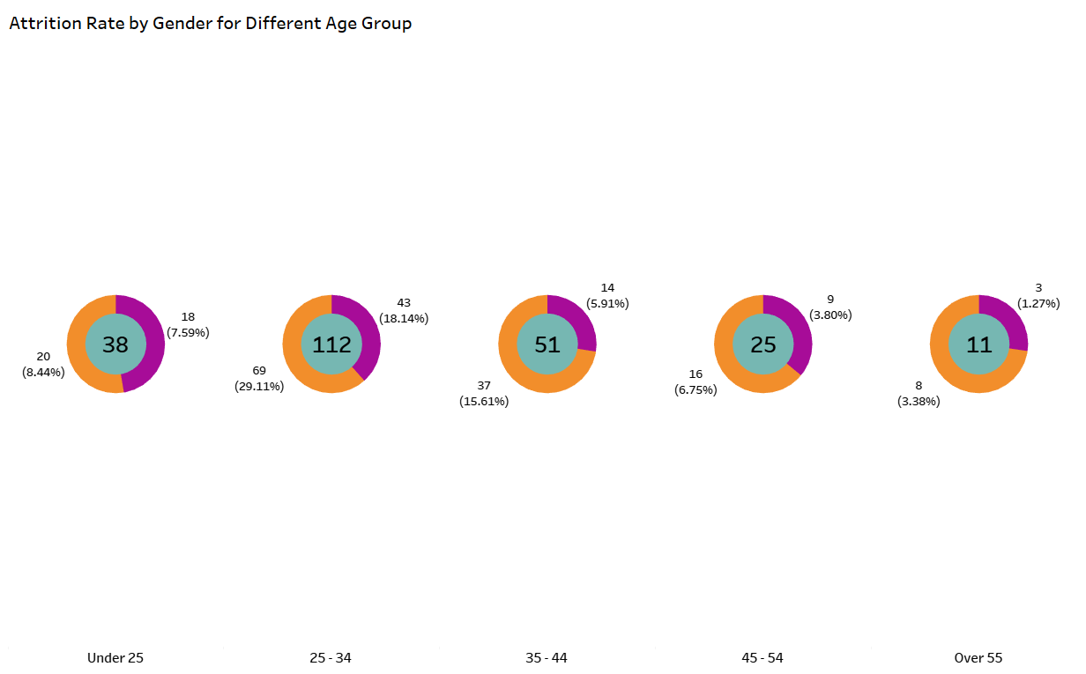
This is a Donut Chart Representation, This chart indicates the Attrition Rate by Gender for Different Age group.
In this Chart : Orange colour Represents Male while Purple colour represents female.
In the first Donut Chart 38 is the Total Attrition Count (which includes males at 20 AC and females at 18 AC).
The male has 8.44% Attrition Count Along Table and the Female has 7.59% Attrition Count Along Table.
The first Donut Chart comes under the employees who are under the age of 25 years.
We can further Analyse the charts represented above.

Slide 11
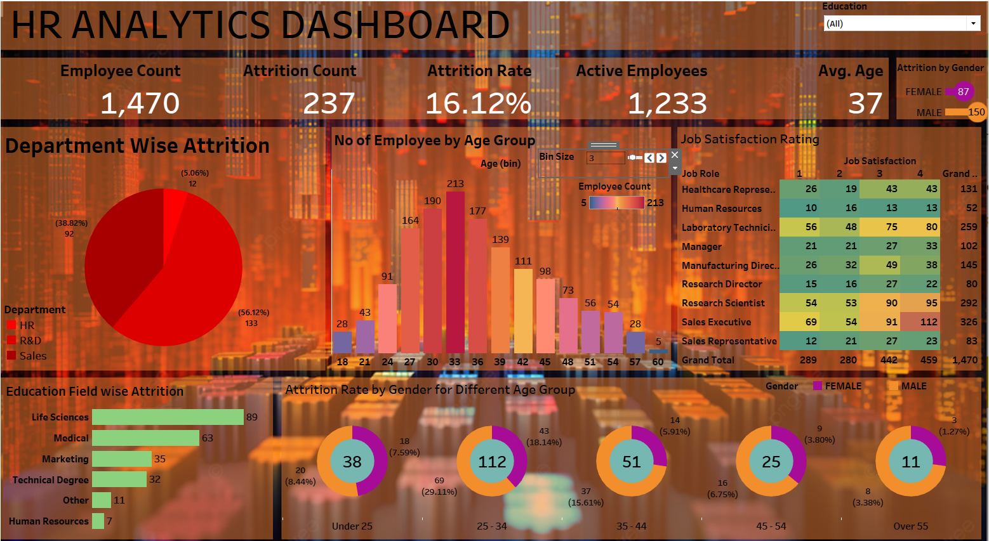
We created the final HR Dashboard by combining all the sheets which represents all the analysed charts.

Slide 12
CONCLUSION
HR Analytics Dashboard typically summarizes the key findings, insights, and implications drawn from the data presented throughout the dashboard.
The most significant insights gleaned from the HR analytics presented on the dashboard. Highlighting key trends, patterns, and notable data points that are relevant to the organization's HR strategies.
It was a wonderful and learning experience for me while working on this project. The joy of working and the thrill involved while tackling the various problems and challenges gave me a feel of the industry. The project gave me the knowledge of Tableau and also an experience to work on it.
I express my gratitude to my guide who played a role in the realization of this project. His dedication and insights significantly enriched the project’s outcomes.

